Slide 1
Semantic Analysis

Slide 2
Semantic Analysis
Having figured out the program’s structure, now figure out what it means

Slide 3
Analysis
of input program
(front-end)
Synthesis
of output program
(back-end)
Compiler Phases
character
stream
Intermediate Code Generation
Lexical Analysis
token
stream
intermediate
form
Syntactic Analysis
Optimization
abstract
syntax tree
intermediate
form
Semantic Analysis
Code Generation
annotated
AST
target
language

Slide 4
Semantic Analysis
Parser uses a CFG(Context-free-Grammar) to validate the input string and produce output for the next phase of the compiler. Output could be either a parse tree or an abstract syntax tree.
The plain parse-tree constructed in the syntax analysis phase is generally of no use for a compiler, as it does not carry any information of how to evaluate the tree
Example: E → E + T
The above CFG production has no semantic rule associated with it, and it cannot help in making any sense of the production!!
Now to interleave semantic analysis with the syntax analysis phase of the compiler, we use Syntax Directed Translation

Slide 5
Semantic Analysis
Semantics of a language provide meaning to its constructs, like tokens and syntax structure
Semantics help interpret symbols, their types, and their relations with each other
Semantic analysis judges whether the syntax structure constructed in the source program derives any meaning or not
CFG + Semantic Rules = Syntax Directed Definitions
Example:
int a = “value”;
This statement should not issue an error in lexical and syntax analysis phase, as it is lexically and structurally correct!!
But it should generate a semantic error as the type of the assignment differs
These rules are set by the grammar of the language and evaluated in semantic analysis.

Slide 6
Semantic Analysis
The following tasks should be performed in semantic analysis:
Scope resolution
Type checking
Array-bound checking
Semantic Errors
Some of the semantics errors that the semantic analyzer is expected to recognize:
Type mismatch
Undeclared variable
Reserved identifier misuse.
Multiple declaration of variable in a scope.
Accessing an out of scope variable.
Actual and formal parameter mismatch.

Slide 7
Semantic Analysis
Functions of Semantic Analysis
1. Type Checking – →Ensures that data types are used in a way consistent with their definition.
2. Label Checking – → A program should contain labels references.
3. Flow Control Check – → Keeps a check that control structures are used in a proper manner.
(Example: no break statement outside a loop)
Example of Type Casting:
float x = 10.1;
float y = x*30;
In the above example integer 30 will be type casted to float 30.0 before multiplication, by semantic analyzer.

Slide 8
Semantic Analysis
Syntax Directed Translation

Slide 9
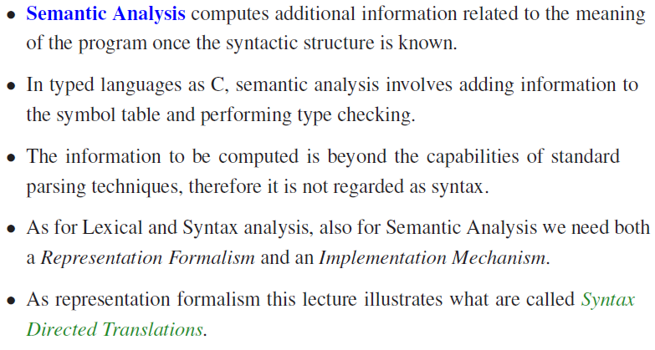
Semantic Analysis

Slide 10
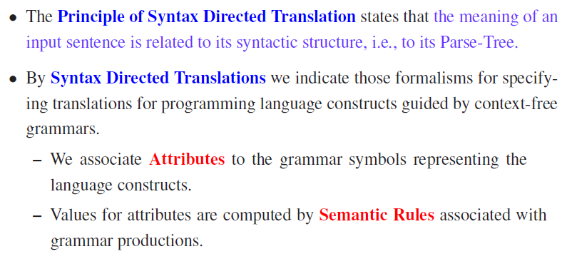
Syntax-Directed Translation

Slide 11
Syntax-Directed Translation
Example: Infix-to-Postfix Translator
Production
Semantic Rule
E->E₁+T
E.code=E₁.code || T.code || ’+’
This production has two nonterminals, E and T;
The subscript in E₁ distinguishes the occurrence of E in the production body from the occurrence of E as the head.
Both E and T have a string-valued attribute code.
The semantic rule specifies that the string E.code is formed by concatenating E₁.code, T.code, and the character ' + ‘ .

Slide 12
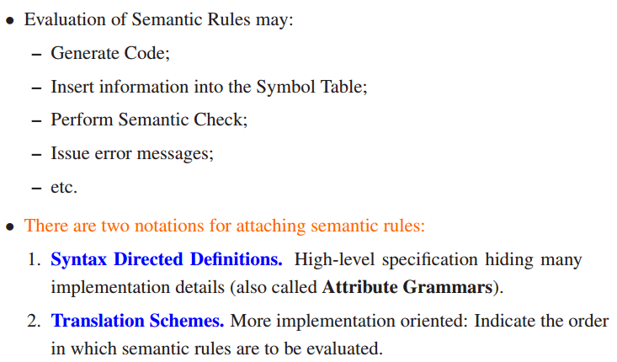
Syntax-Directed Translation

Slide 13
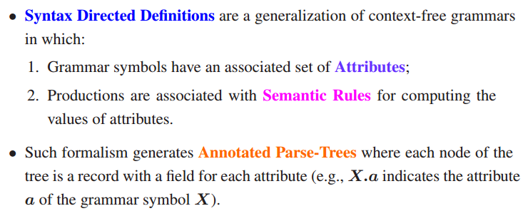
Syntax-Directed Definition
Notes:
A SDD is a context free grammar with attributes and rules
Attributes are associated with grammar symbols and rules with productions
Attributes may be of many kinds: numbers, types, table references, strings, etc.

Slide 14
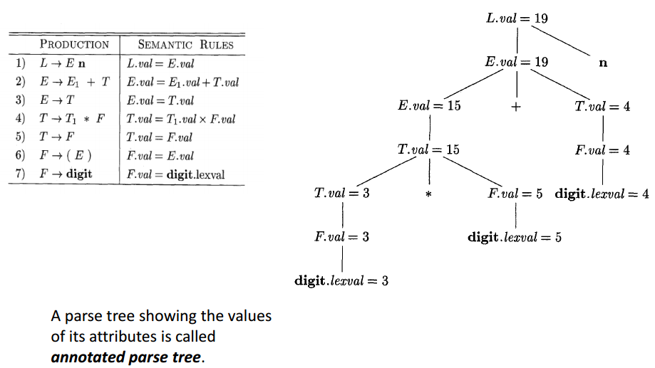
Syntax-Directed Definition
Syntax-directed definition of
a simple desk calculator
Annotated Parse Tree for 3 * 5 + 4n
Notes:
See Text book for Explanation..
The rule for production 1, L → E n, sets L.val to E.val, which we shall see is the numerical value of the entire expression. Production 2, E → E₁ + T, also has one rule, which computes the val attribute for the head E as the sum of the values at E₁ and T.
At any parse tree node N labeled E, the value of val for E is the sum of the values of val at the children of node N labeled E and T. Production 3, E + T, has a single rule that defines the value of val for E to be the same as the value of val at the child for T.
Production 4 is similar to the second production; its rule multiplies the values at the children instead of adding them.
The rules for productions 5 and 6 copy values at a child, like that for the third production.
Production 7 gives F.val the value of a digit, that is, the numerical value of the token digit that the lexical analyzer returned.

Slide 15
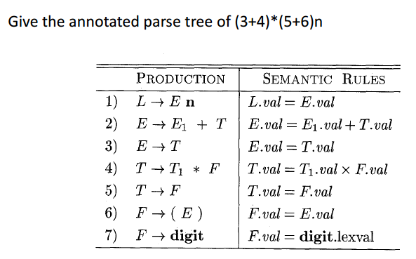
Syntax-Directed Definition
?

Slide 16
Attribute Grammar
A special form of context-free grammar where some additional information (attributes) are appended to one or more of its non-terminals in order to provide context-sensitive information.
Each attribute has well-defined domain of values, such as integer, float, character, string, and expressions
Attribute grammar is a medium to provide semantics to the context-free grammar and it can help specify the syntax and semantics of a programming language.
Attribute grammar (when viewed as a parse-tree) can pass values or information among the nodes of a tree.

Slide 17
Attribute Grammar
Example:
The right part of the CFG contains the semantic rules that specify how the grammar should be interpreted.
Here, the values of non-terminals E and T are added together and the result is copied to the non-terminal E.
Production
Semantic Rule

Slide 18
Two Types of Attributes
Semantic attributes may be assigned to their values from their domain at the time of parsing and evaluated at the time of assignment or conditions.
Based on the way the attributes get their values, they can be broadly divided into two categories : synthesized attributes and inherited attributes.
(1) Synthesized attributes
→These attributes get values from the attribute values of their child nodes. (Variables in the RHS of the production).
→ These attributes are the non-terminals on the left-hand side of a production.
(2) Inherited attributes
→ These attributes can take values from parent and/or siblings. (variables in the LHS or RHS of the production).
→These attributes are nonterminal on the right-hand side of a production

Slide 19
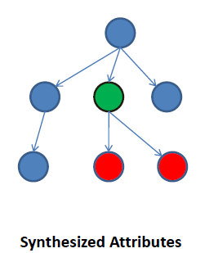

Two types of attributes
S → ABC
If S is taking values from its child nodes (A,B,C), then it is said to be a synthesized attribute, as the values of ABC are synthesized to S.
E → E + T
The parent node E gets its value from its child node.

Slide 20
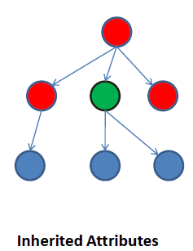
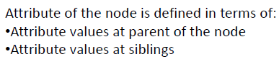
Two types of attributes
S → ABC
A can get values from S, B and C. B can take values from S, A, and C.
Likewise, C can take values from S, A, and B.

Slide 21
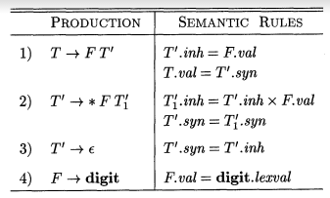
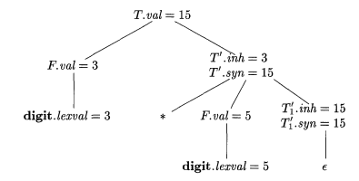
Example
AN SDD based on a grammar suitable for top-down parsing
Annotated Parse Tree for 3 * 5
Notes:
See Text book for Explanation..
To see how the semantic rules are used, consider the annotated parse tree for 3 * 5 in Fig. 5.5. The leftmost leaf in the parse tree, labeled digit, has attribute value lexval = 3, where the 3 is supplied by the lexical analyzer. Its parent is for production 4, F → digit. The only semantic rule associated with this production defines F.val = digit.lexval, which equals 3.
At the second child of the root, the inherited attribute T’.inh is defined by the semantic rule T’.inh = F.val associated with production 1. Thus, the left operand, 3, for the * operator is passed from left to right across the children of the root.
The production at the node for T’ is T’ → * FT₁’
(We retain the subscript 1 in the annotated parse tree to distinguish between the two nodes for T’.)
The inherited attribute T₁’.inh is defined by the semantic rule T₁’.inh = T₁’.inh * F.val associated with production 2.
With T’.inh = 3 and F.val = 5, we get T₁’.inh = 15. At the lower node for T₁’, the production is T’→ empty string . The semantic rule T’.syn = T’.inh defines T₁’.syn = 15. The syn attributes at the nodes for T' pass the value 15 up the tree to the node for T , where T.val = 15.

Slide 22
Example
AN SDD based on a grammar suitable for top-down parsing
Synthesized Attribute
Annotated Parse Tree for 3 * 5

Slide 23
Example
AN SDD based on a grammar suitable for top-down parsing
Inherited Attribute
Annotated Parse Tree for 3 * 5

Slide 24
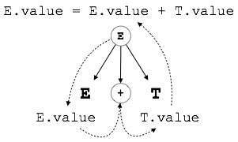
Syntax directed translation
S-attributed SDT :
If an SDT uses only synthesized attributes, it is called as S-attributed SDT.
S-attributed SDTs are evaluated in bottom-up parsing/ post order traversal, as the values of the parent nodes depend upon the values of the child nodes.
Semantic actions are placed in rightmost place of RHS.

Slide 25
Syntax directed translation
L-attributed SDT:
If an SDT uses both synthesized attributes and inherited attributes with a restriction that inherited attribute can inherit values from left siblings only, it is called as L-attributed SDT.
Attributes in L-attributed SDTs are evaluated by depth-first and left-to-right parsing manner.
Semantic actions are placed anywhere in RHS.
S → ABC
S can take values from A, B, and C (synthesized).
A can take values from S only.
B can take values from S and A.
C can get values from S, A, and B.
No non-terminal can get values from the sibling to its right.

Slide 26
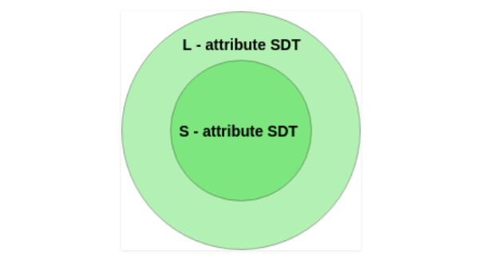
Syntax directed translation
We may conclude that if a definition is S-attributed, then it is also L-attributed as L-attributed definition encloses S-attributed definitions.

Slide 27
Semantic Analysis
Type Checking and Symbol table

Slide 28
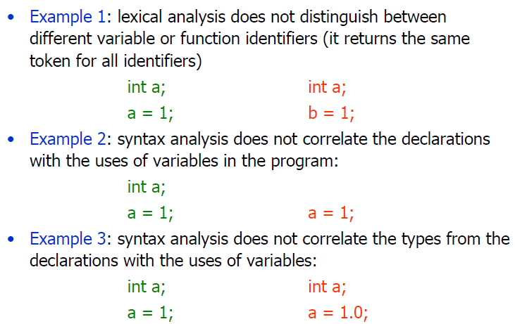
Incorrect Programs

Slide 29
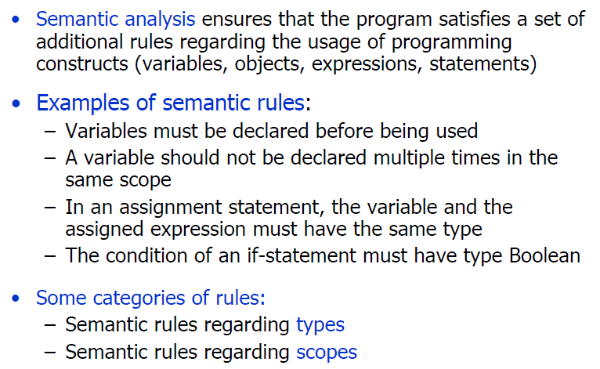
Goals of semantic analysis

Slide 30
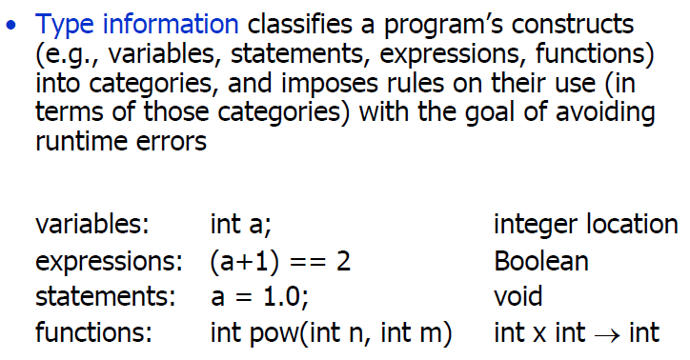
Type Information

Slide 31
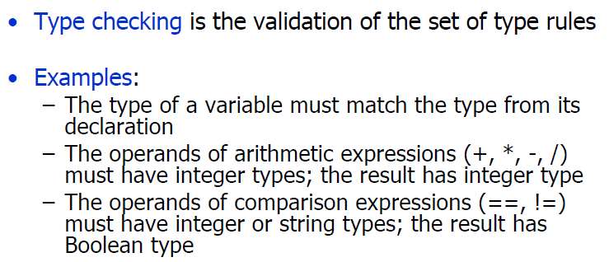
Type checking

Slide 32
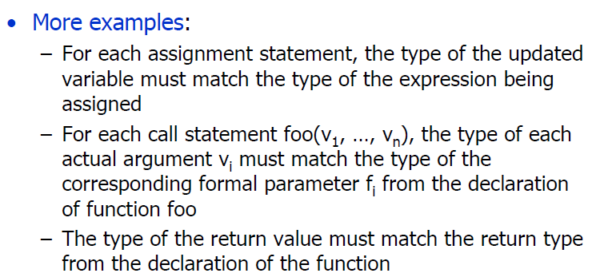
Type checking

Slide 33
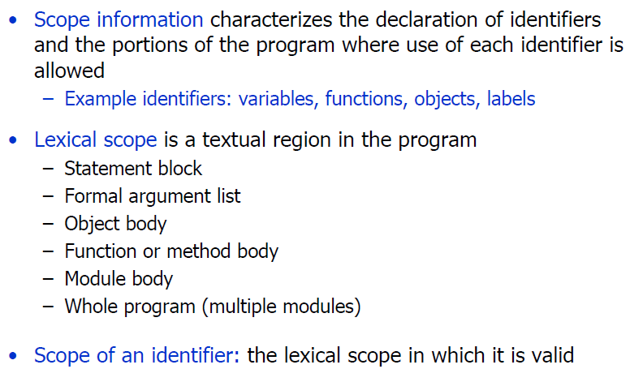
Scope information

Slide 34
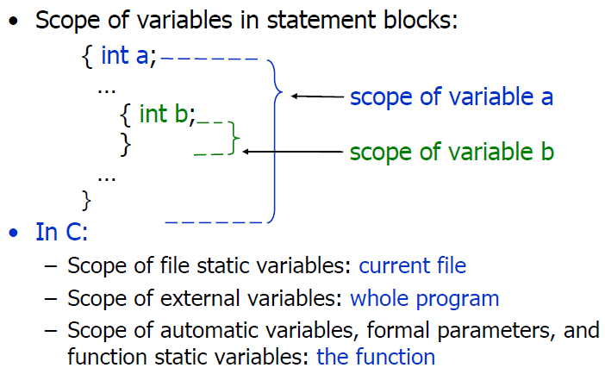
Scope information

Slide 35
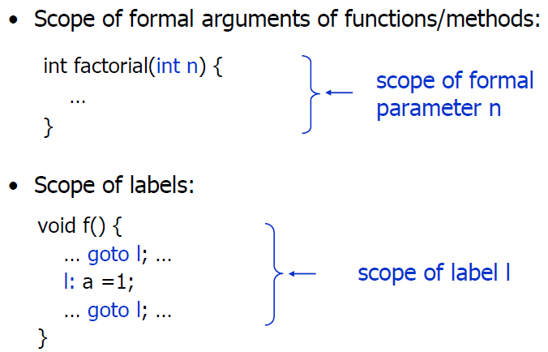
Scope information

Slide 36
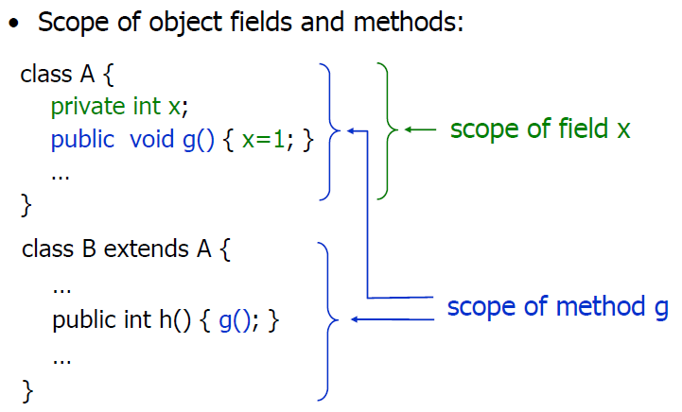
Scope information

Slide 37
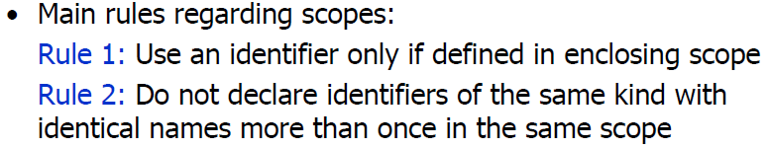
Semantic rules for Scope

Slide 38
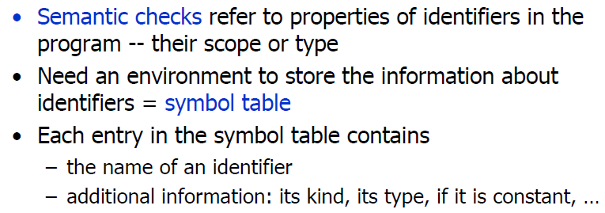

Symbol tables
Notes:
https://iq.opengenus.org/symbol-table-in-compiler/

Slide 39
Symbol tables
A symbol table is simply a table which can be either linear or a hash table.
It maintains an entry for each name in the following format:
<symbol name, type, attribute>
For example, if a symbol table has to store information about the following variable declaration:
static int interest;
then it should store the entry such as:
<interest, int, static>
The attribute clause contains the entries related to the name
Notes:
https://www.geeksforgeeks.org/symbol-table-compiler/
https://www.tutorialspoint.com/compiler_design/compiler_design_symbol_table.htm
https://iq.opengenus.org/symbol-table-in-compiler/

Slide 40
Symbol tables
An important data structure created and maintained by the compiler in order to keep track of semantics of variables i.e. it stores information about the scope and binding information about names, information about instances of various entities such as variable and function names, classes, objects, etc.
A symbol table may serve the following purposes depending upon the language in hand:
To store the names of all entities in a structured form at one place.
To verify if a variable has been declared.
To implement type checking, by verifying assignments and expressions in the source code are semantically correct.
To determine the scope of a name (scope resolution).
Notes:
https://www.geeksforgeeks.org/symbol-table-compiler/
https://www.tutorialspoint.com/compiler_design/compiler_design_symbol_table.htm
https://iq.opengenus.org/symbol-table-in-compiler/

Slide 41
Symbol tables
It is used by various phases of the compiler as follows:-
Lexical Analysis: Creates new table entries in the table, for example like entries about tokens.
Syntax Analysis: Adds information regarding attribute type, scope, dimension, line of reference, use, etc in the table.
Semantic Analysis: Uses available information in the table to check for semantics i.e. to verify that expressions and assignments are semantically correct(type checking) and update it accordingly.
Intermediate Code generation: Refers symbol table for knowing how much and what type of run-time is allocated and table helps in adding temporary variable information.
Code Optimization: Uses information present in the symbol table for machine-dependent optimization.
Target Code generation: Generates code by using address information of identifier present in the table.
Notes:
https://www.geeksforgeeks.org/symbol-table-compiler/
https://www.tutorialspoint.com/compiler_design/compiler_design_symbol_table.htm
https://iq.opengenus.org/symbol-table-in-compiler/

Slide 42
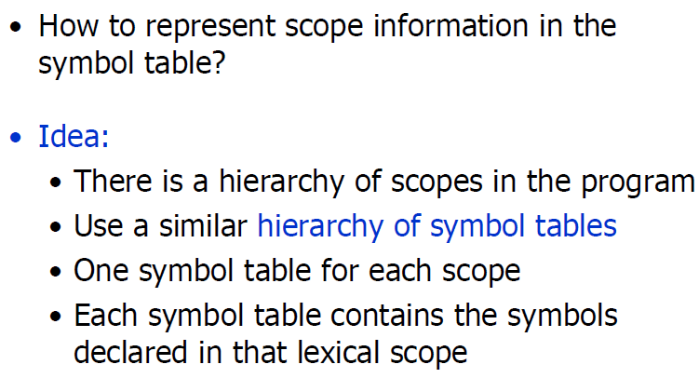
Scope Information in symbol table

Slide 43
Scope Information in symbol table
A compiler maintains two types of symbol tables:
(1) A global symbol table which can be accessed by all the procedures and
(2) Scope symbol tables that are created for each scope in the program.
To determine the scope of a name, symbol tables are arranged in hierarchical structure as shown in the example below:

Slide 44
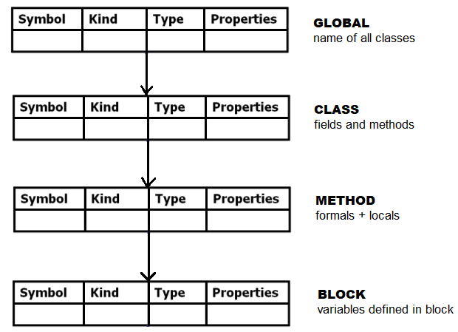
Scope Information in symbol table
The following is the scope nesting mirrored hierarchy of symbol tables:

Slide 45
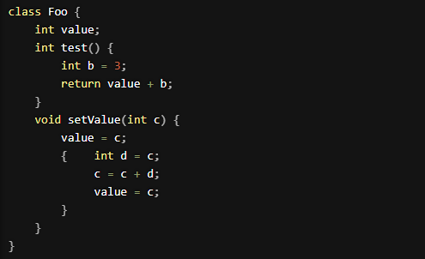
Example-1

Slide 46
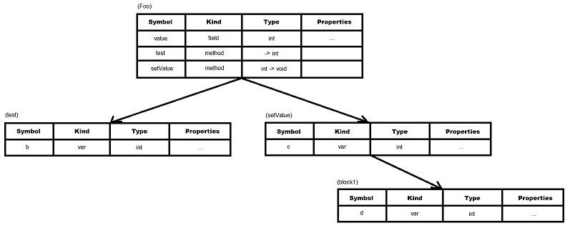
Example-1

Slide 47
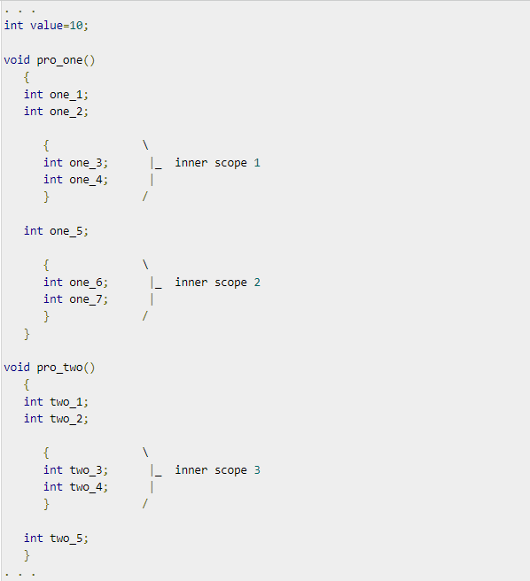
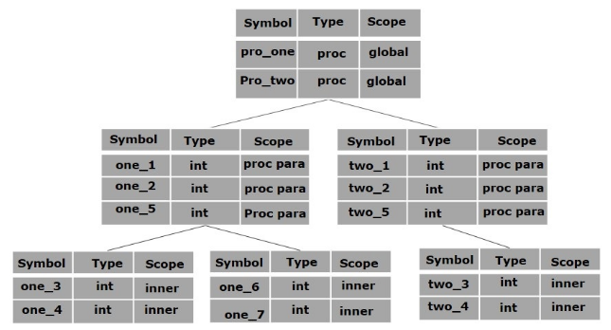
Example-2
The above program can be represented in a hierarchical structure of symbol tables:

Slide 48
Example-2
The global symbol table contains names for one global variable (int value) and two procedure names, which should be available to all the child nodes shown above.
The names mentioned in the pro_one symbol table (and all its child tables) are not available for pro_two symbols and its child tables.
This symbol table data structure hierarchy is stored in the semantic analyzer and whenever a name needs to be searched in a symbol table, it is searched using the following algorithm:
(1) First a symbol will be searched in the current scope, i.e. current symbol table.
(2) If a name is found, then search is completed, else it will be searched in the parent
symbol table until, either the name is found or global symbol table has been searched
for the name.

Slide 49
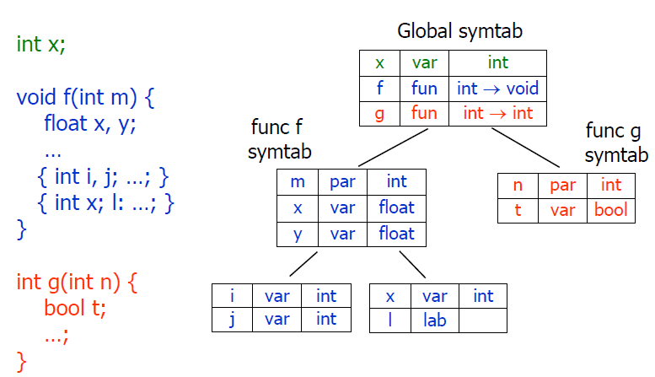
Example-3

Slide 50
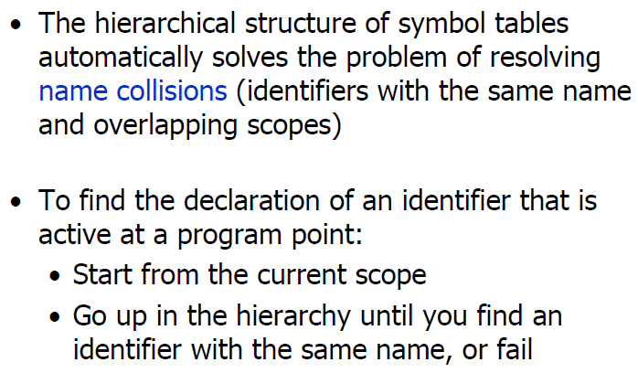
Identifiers with same name

Slide 51
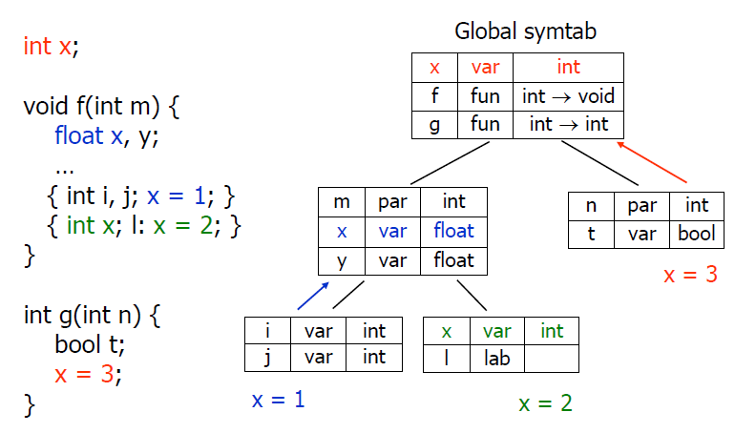
Example-3

Slide 52
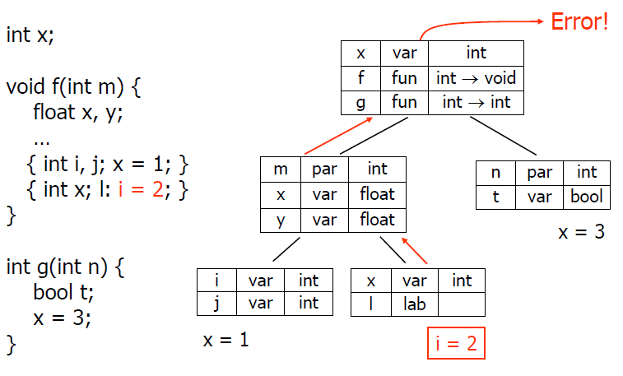
Catching semantic errors

Slide 53
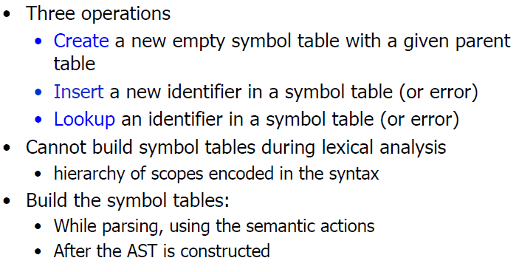
Symbol table operations

Slide 54
Symbol table Implementation
If a compiler is to handle a small amount of data, then the symbol table can be implemented as an unordered list, which is easy to code, but it is only suitable for small tables only.
A symbol table can be implemented in one of the following ways:
Linear (sorted or unsorted) list
Binary Search Tree
Hash table

Slide 55
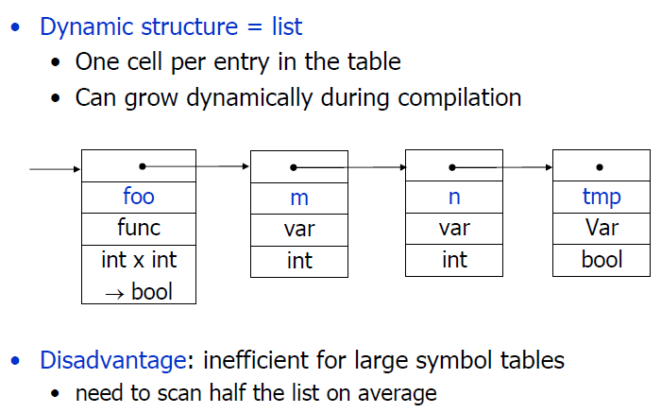
List implementation

Slide 56
List implementation
Symbol tables are mostly implemented as hash tables, where the source code symbol itself is treated as a key for the hash function and the return value is the information about the symbol.
In hashing scheme, two tables are maintained – a hash table and symbol table and are the most commonly used method to implement symbol tables.
A hash table is an array with an index range: 0 to table size – 1. These entries are pointers pointing to the names of the symbol table.
To search for a name we use a hash function that will result in an integer between 0 to table size – 1.
Insertion and lookup can be made very fast – O(1).
The advantage is quick to search is possible and the disadvantage is that hashing is complicated to implement.

Slide 57
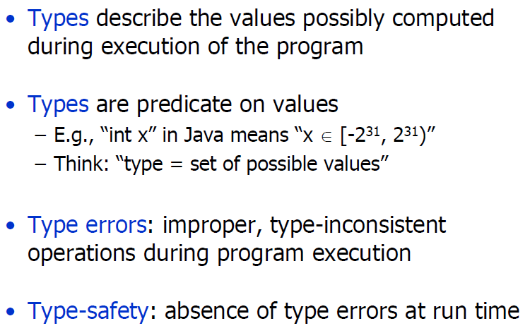
Back to type checking

Slide 58
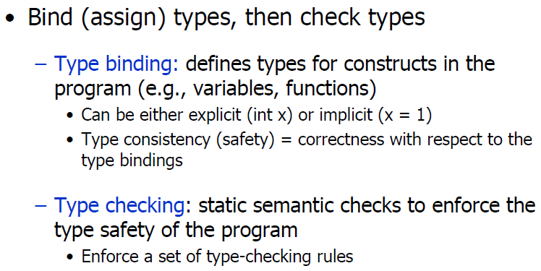
Ensuring type-safety

Slide 59
4 concepts related to types/ languages
Static vs. Dynamic Checking
When to check types
Static vs. Dynamic Typing
When to define types
Strong vs. Weak Typing
How many Type Errors
Sound Type Systems
Statically catch all type of errors

Slide 60
Static vs. dynamic checking
Static Type Checking
Checking at compile time
Dynamic Type Checking
Checking at run time (program execution time)
Example
Static Type Checking: Type checks, Flow-of-control checks
Dynamic Type Checking: Division by Zero error, Array bounds checking,
Null pointer dereferences

Slide 61
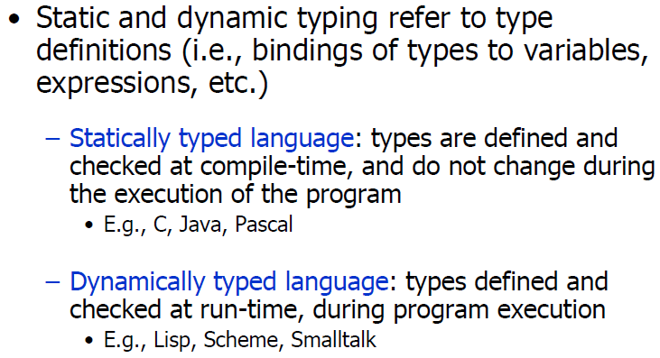
Static vs. dynamic typing

Slide 62
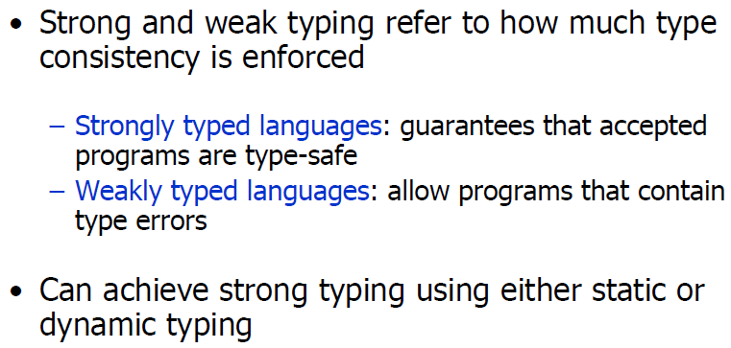
Strong vs. weak typing

Slide 63
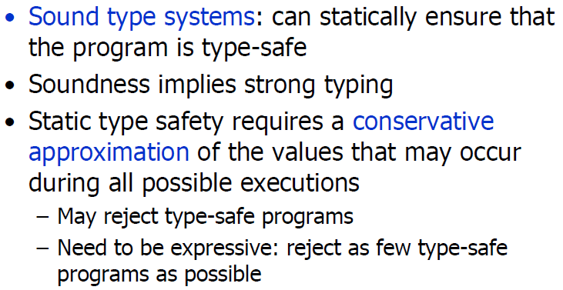
soundness

Slide 64
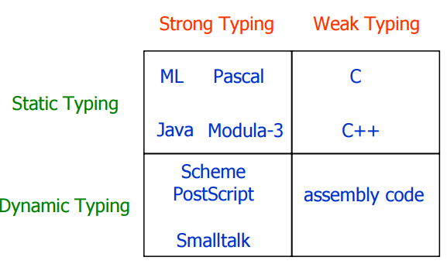
Classification

Slide 65
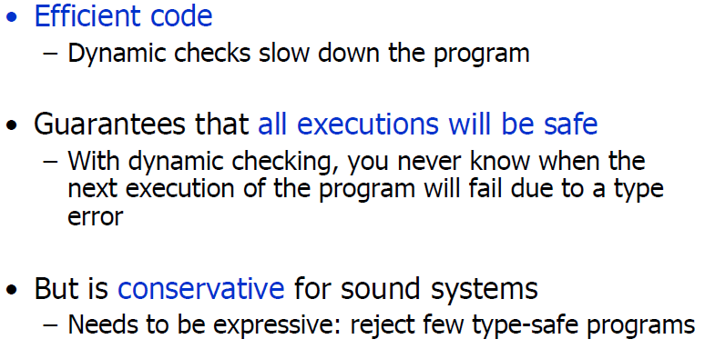
Why static checking ?

Slide 66
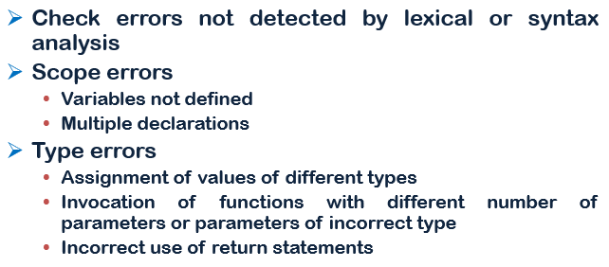
Summary: semantic analysis

Slide 67
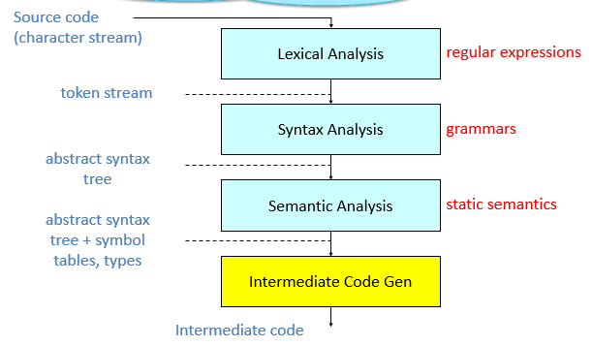
Where we are………
Notes:
A SDD is a context free grammar with attributes and rules
Attributes are associated with grammar symbols and rules with productions
Attributes may be of many kinds: numbers, types, table references, strings, etc.

Slide 68
Lecture Materials
Reference Book: Compilers ( Principles, Techniques and Tools) Second Edition
Chapter-5:Syntax-Directed Translation
Web Tutorials:
https://www.tutorialspoint.com/compiler_design/compiler_design_semantic_analysis.htm
https://www.geeksforgeeks.org/syntax-directed-translation-in-compiler-design/

Slide 69
The End

